Slide 1
Paiute Culture
Tools and Art

Slide 2
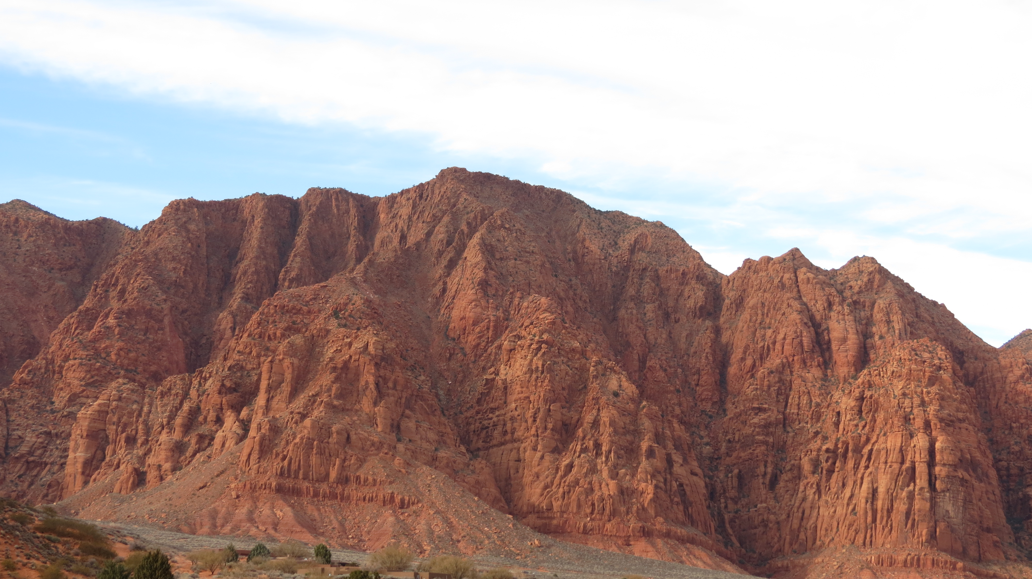
Notes:
Nextdoor to current day Shivwits Paiute Reservation. Paiutes live on valley floor, in ancient times they would have set up their wikiups at the top of these mountains to be cooler.

Slide 3
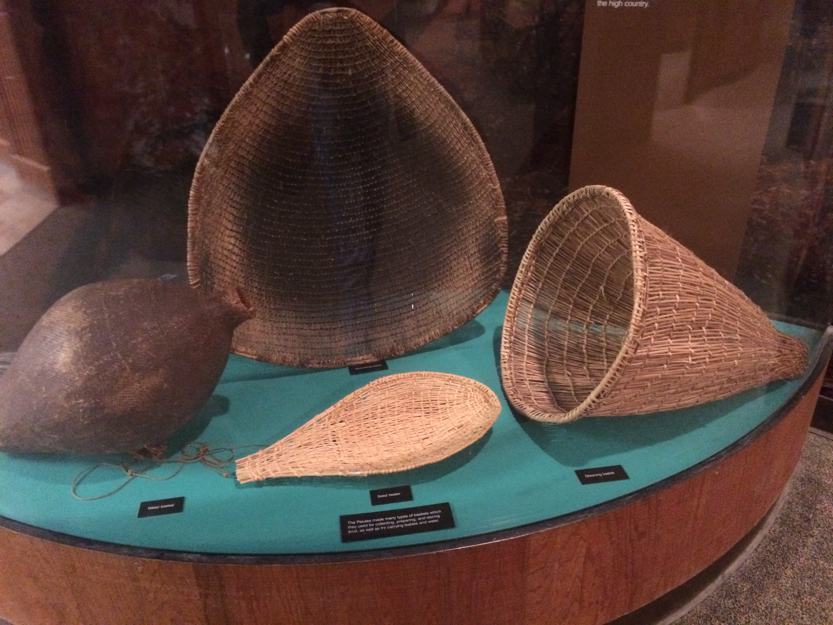
Notes:
From left to right, clockwise: Water basket, shallow basket, gathering basket, paddle for loosening rice grass seeds?

Slide 4
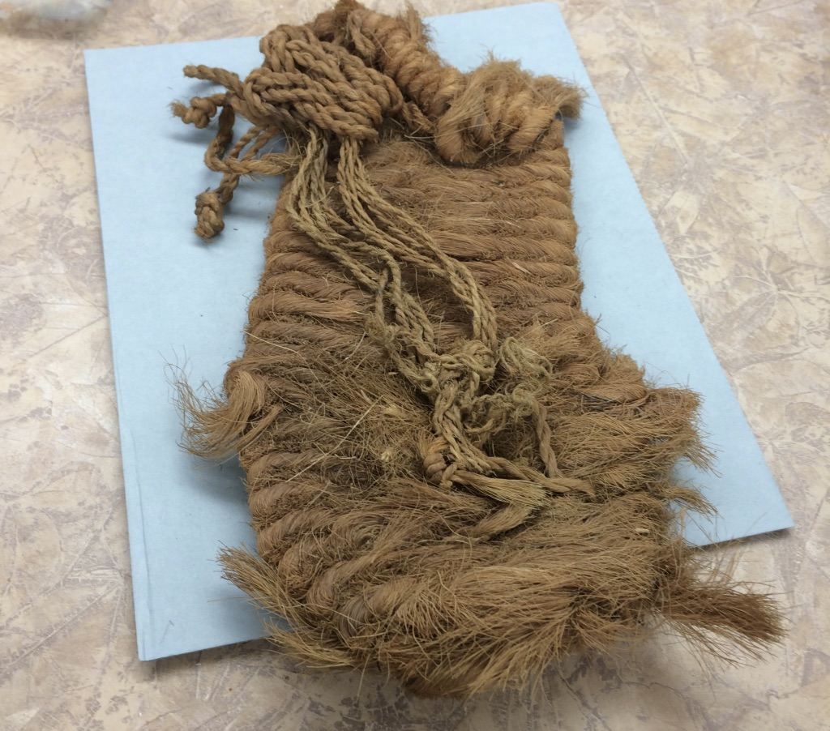
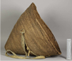
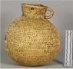
Notes:
Gathering basket and basket for liquids

Slide 5
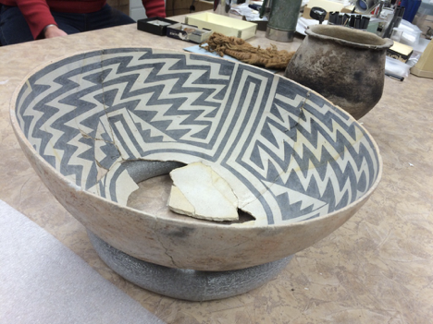
Notes:
Decorated pottery foreground. Utilitarian pot background

Slide 6
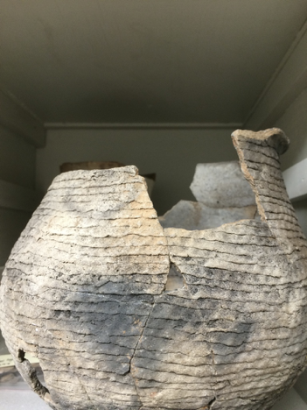
Notes:
Pottery vessel. Coils that were used to make it are visible.

Slide 7
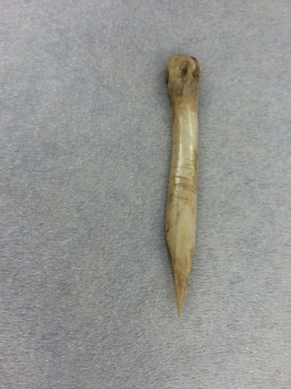
Notes:
Bone awl for sewing

Slide 8
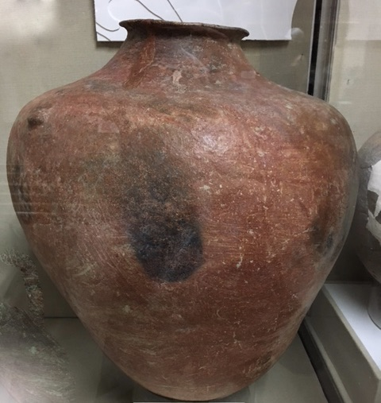
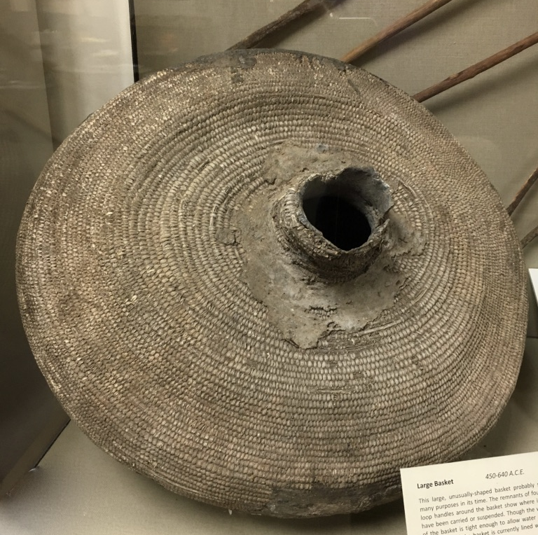
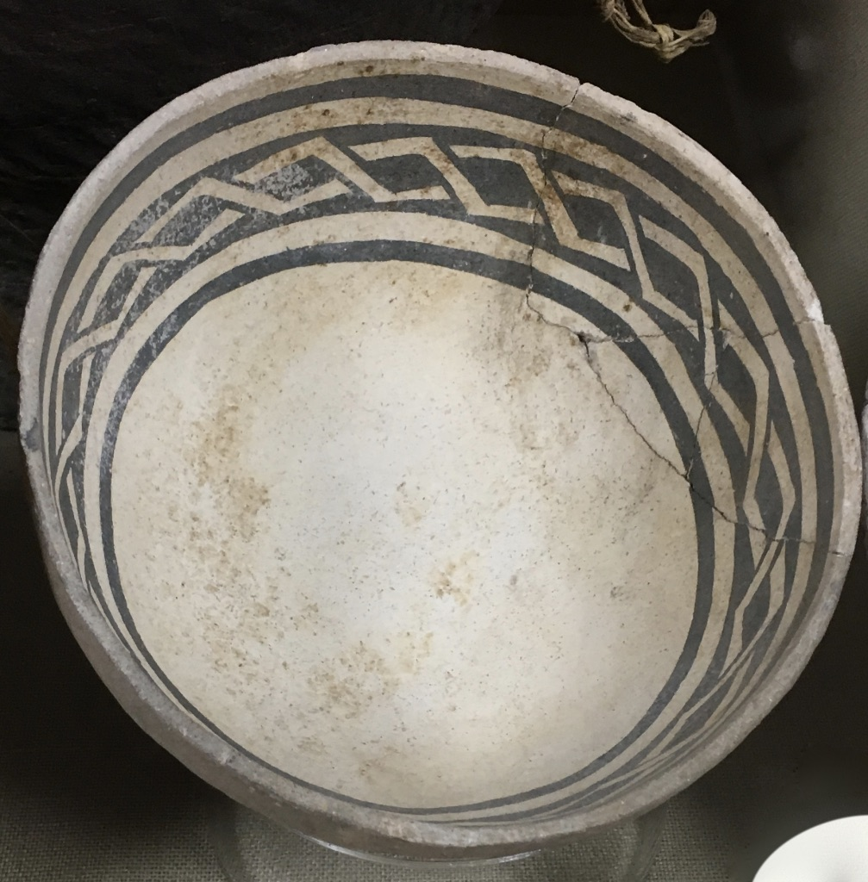
Notes:
Ancient pottery from Bureau of Land Management display, St. George, Utah.

Slide 9
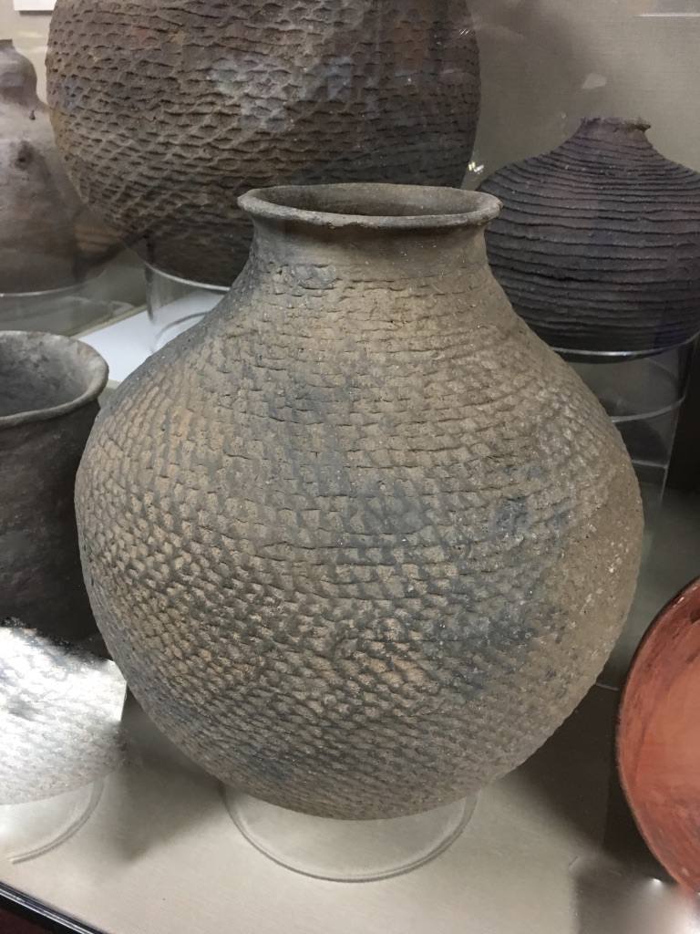
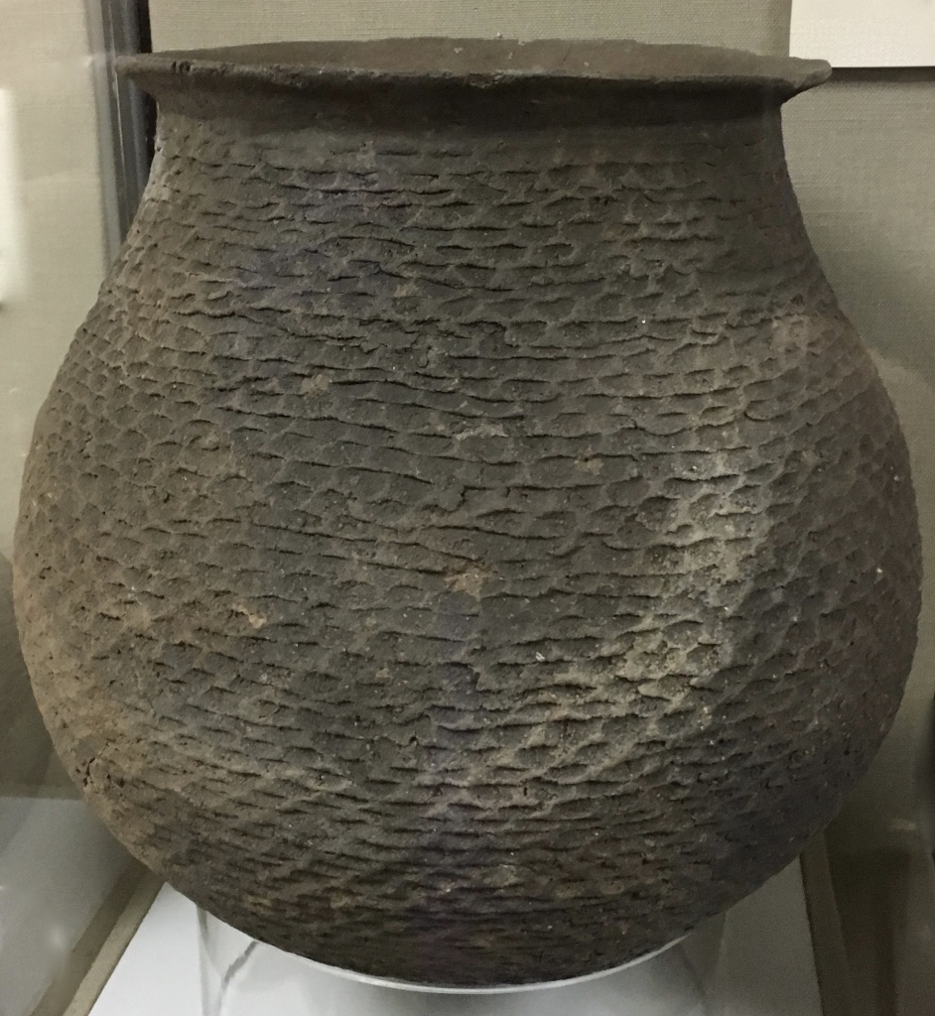
Notes:
Ancient pottery from Bureau of Land Management Display, St. George Utah.

Slide 10
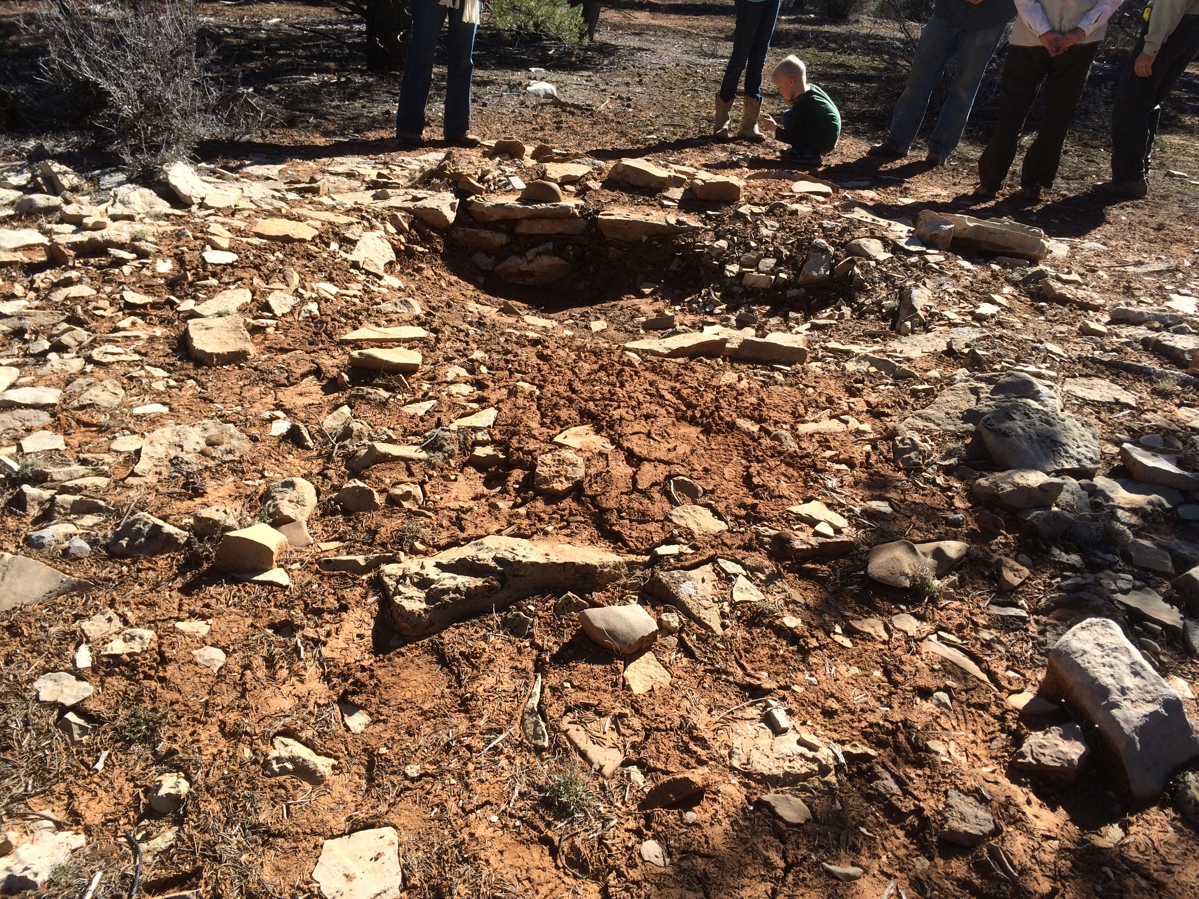
Notes:
Location that inspired author to have grandmother show Vivian the ancient ruin. See the circular hole where a wikiup would have been anchored. Pottery sherds and shale littered the ground.

Slide 11
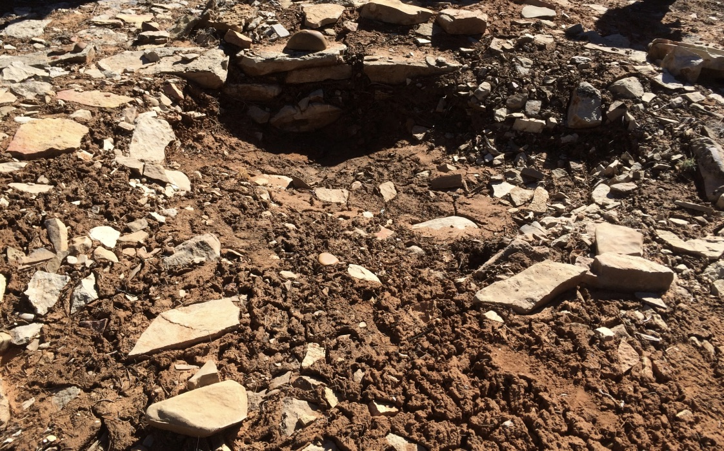
Notes:
Location that inspired author to have grandmother show Vivian the ancient ruin. See the circular hole where a wikiup would have been anchored. Pottery sherds and shale littered the ground.

Slide 12
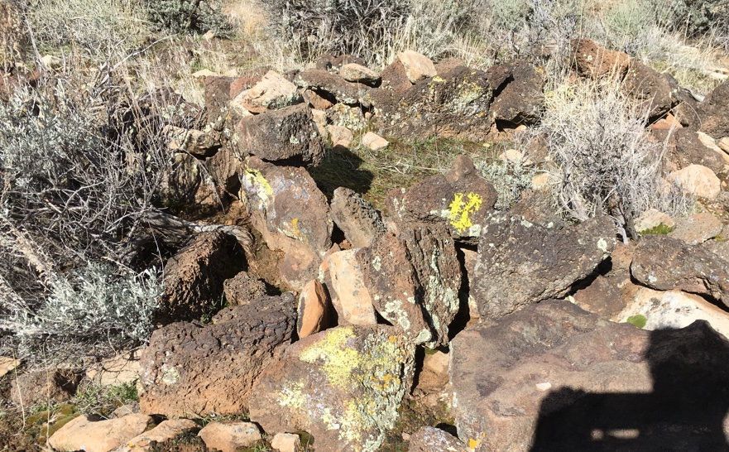
Notes:
Would you choose this as your home like the Paiutes did?

Slide 13
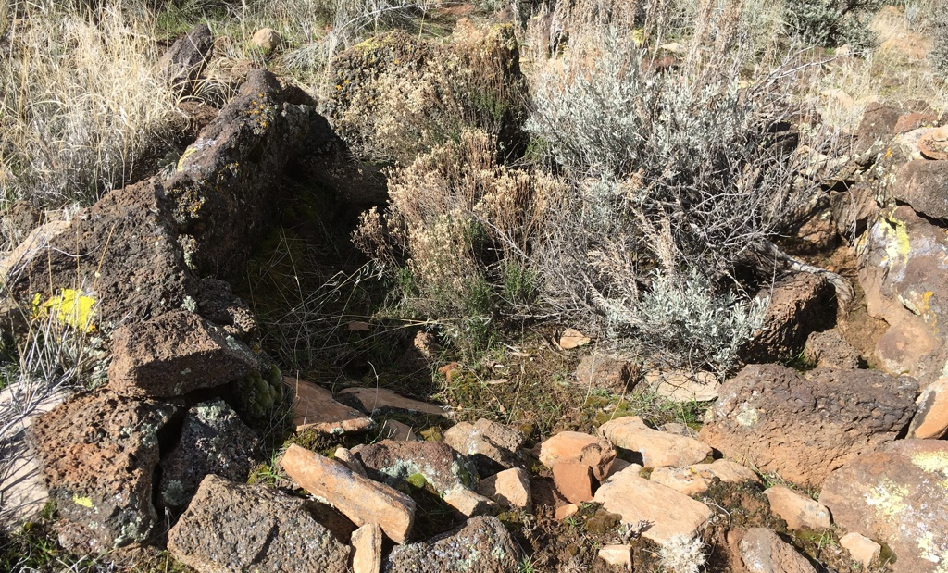
Notes:
Would you choose this as your home like the Paiutes did?

Slide 14
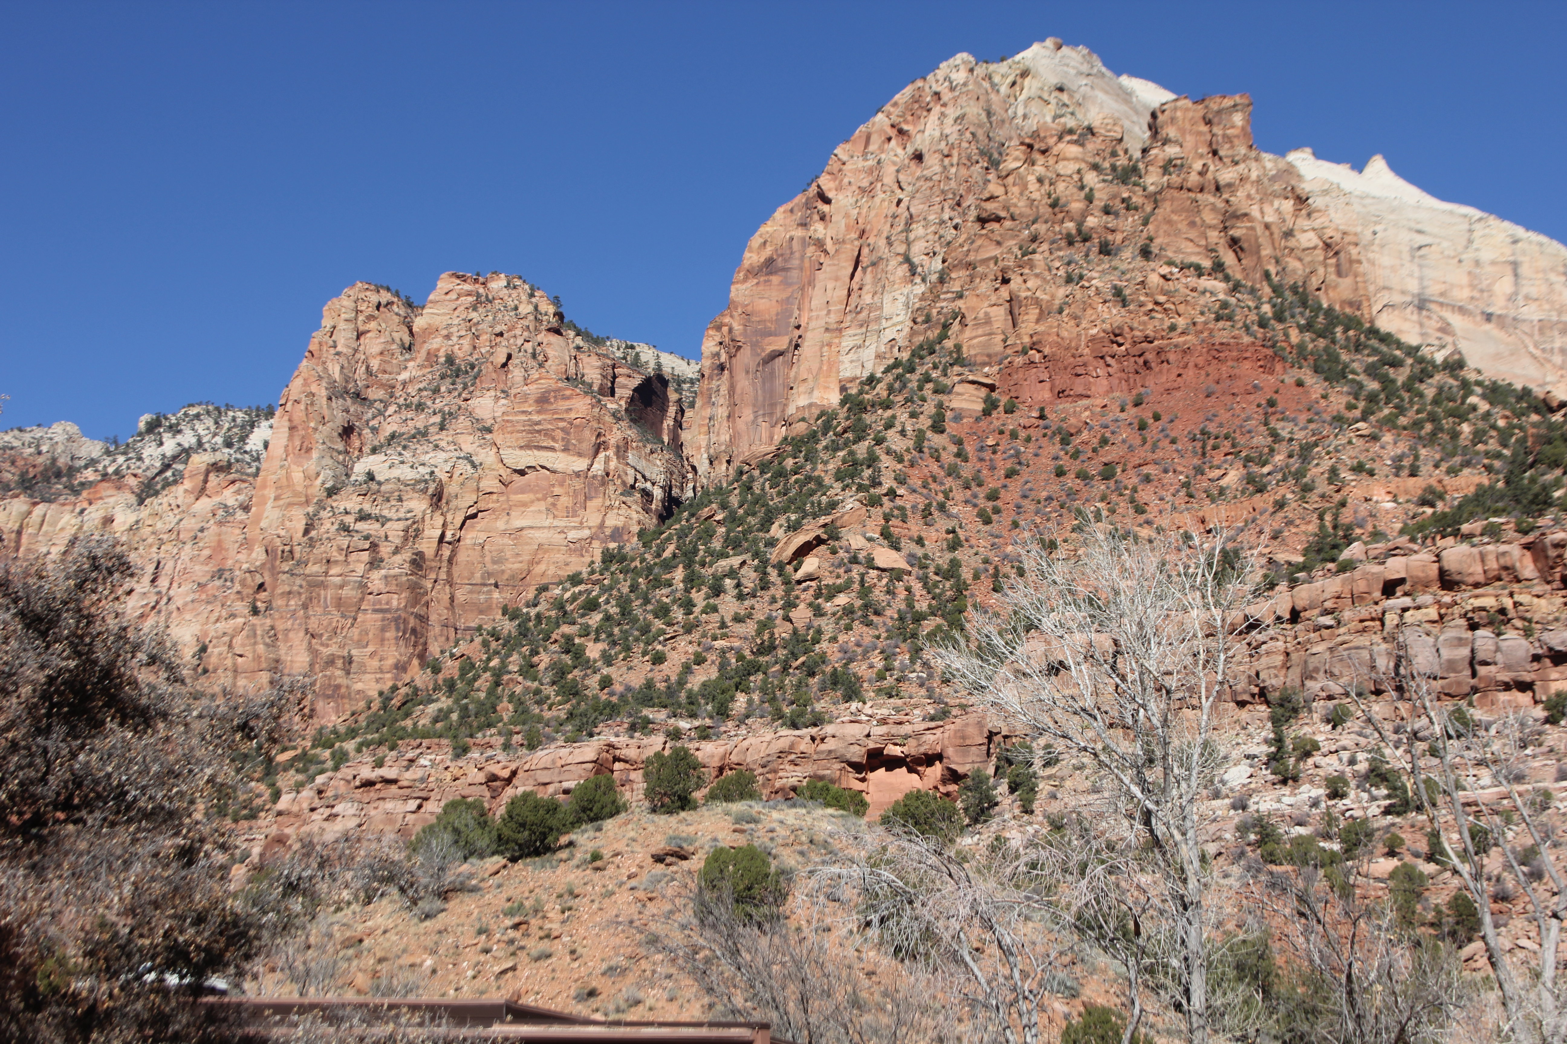
Notes:
Paiute home land is on a sandstone base with volcanoes and lava nearby. It is high desert. Sandstone gets its colors from oxidizing iron. Different colors mean different stages of oxidation. White sandstone means the iron has been leached down by water.

Slide 15
Notes:
Desert varnish is a coating laid down on sandstone by bacteria in arid climates. The coating is reddish brown and it is made of manganese and iron.

Slide 16
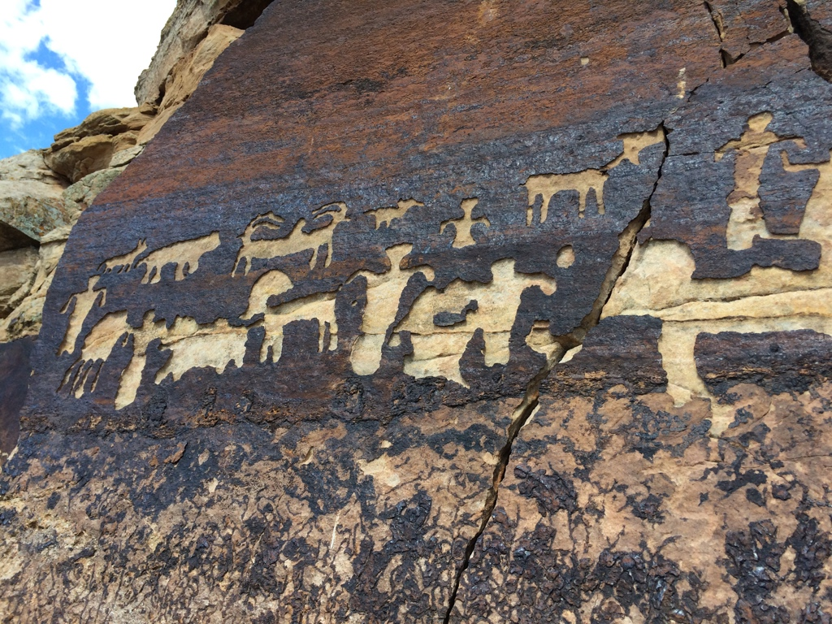
Notes:
When the Ancient People lived in Paiute territory, they left their artwork, or symbols in the rock. The ancient ones pecked through the desert varnish with rocks to reveal the design in the lighter colored rock beneath. We call these symbols petroglyphs which means a picture or symbol in stone. In this panel, the Ancient People uncovered the whole shape, not just the outline.
No one really knows the purpose of petroglyphs but it is thought that some may have religious significance, like telling the story of the people’s origin. Other petroglyphs may show how many times a particular band has camped in the area by pecking out their clan symbol. Some may be maps. Others may tell what kind of game is nearby. They are all amazing and they were pecked from 900 to 1000 years ago in the area close to the Shivwitz Paiute reservation and in other sites.

Slide 17
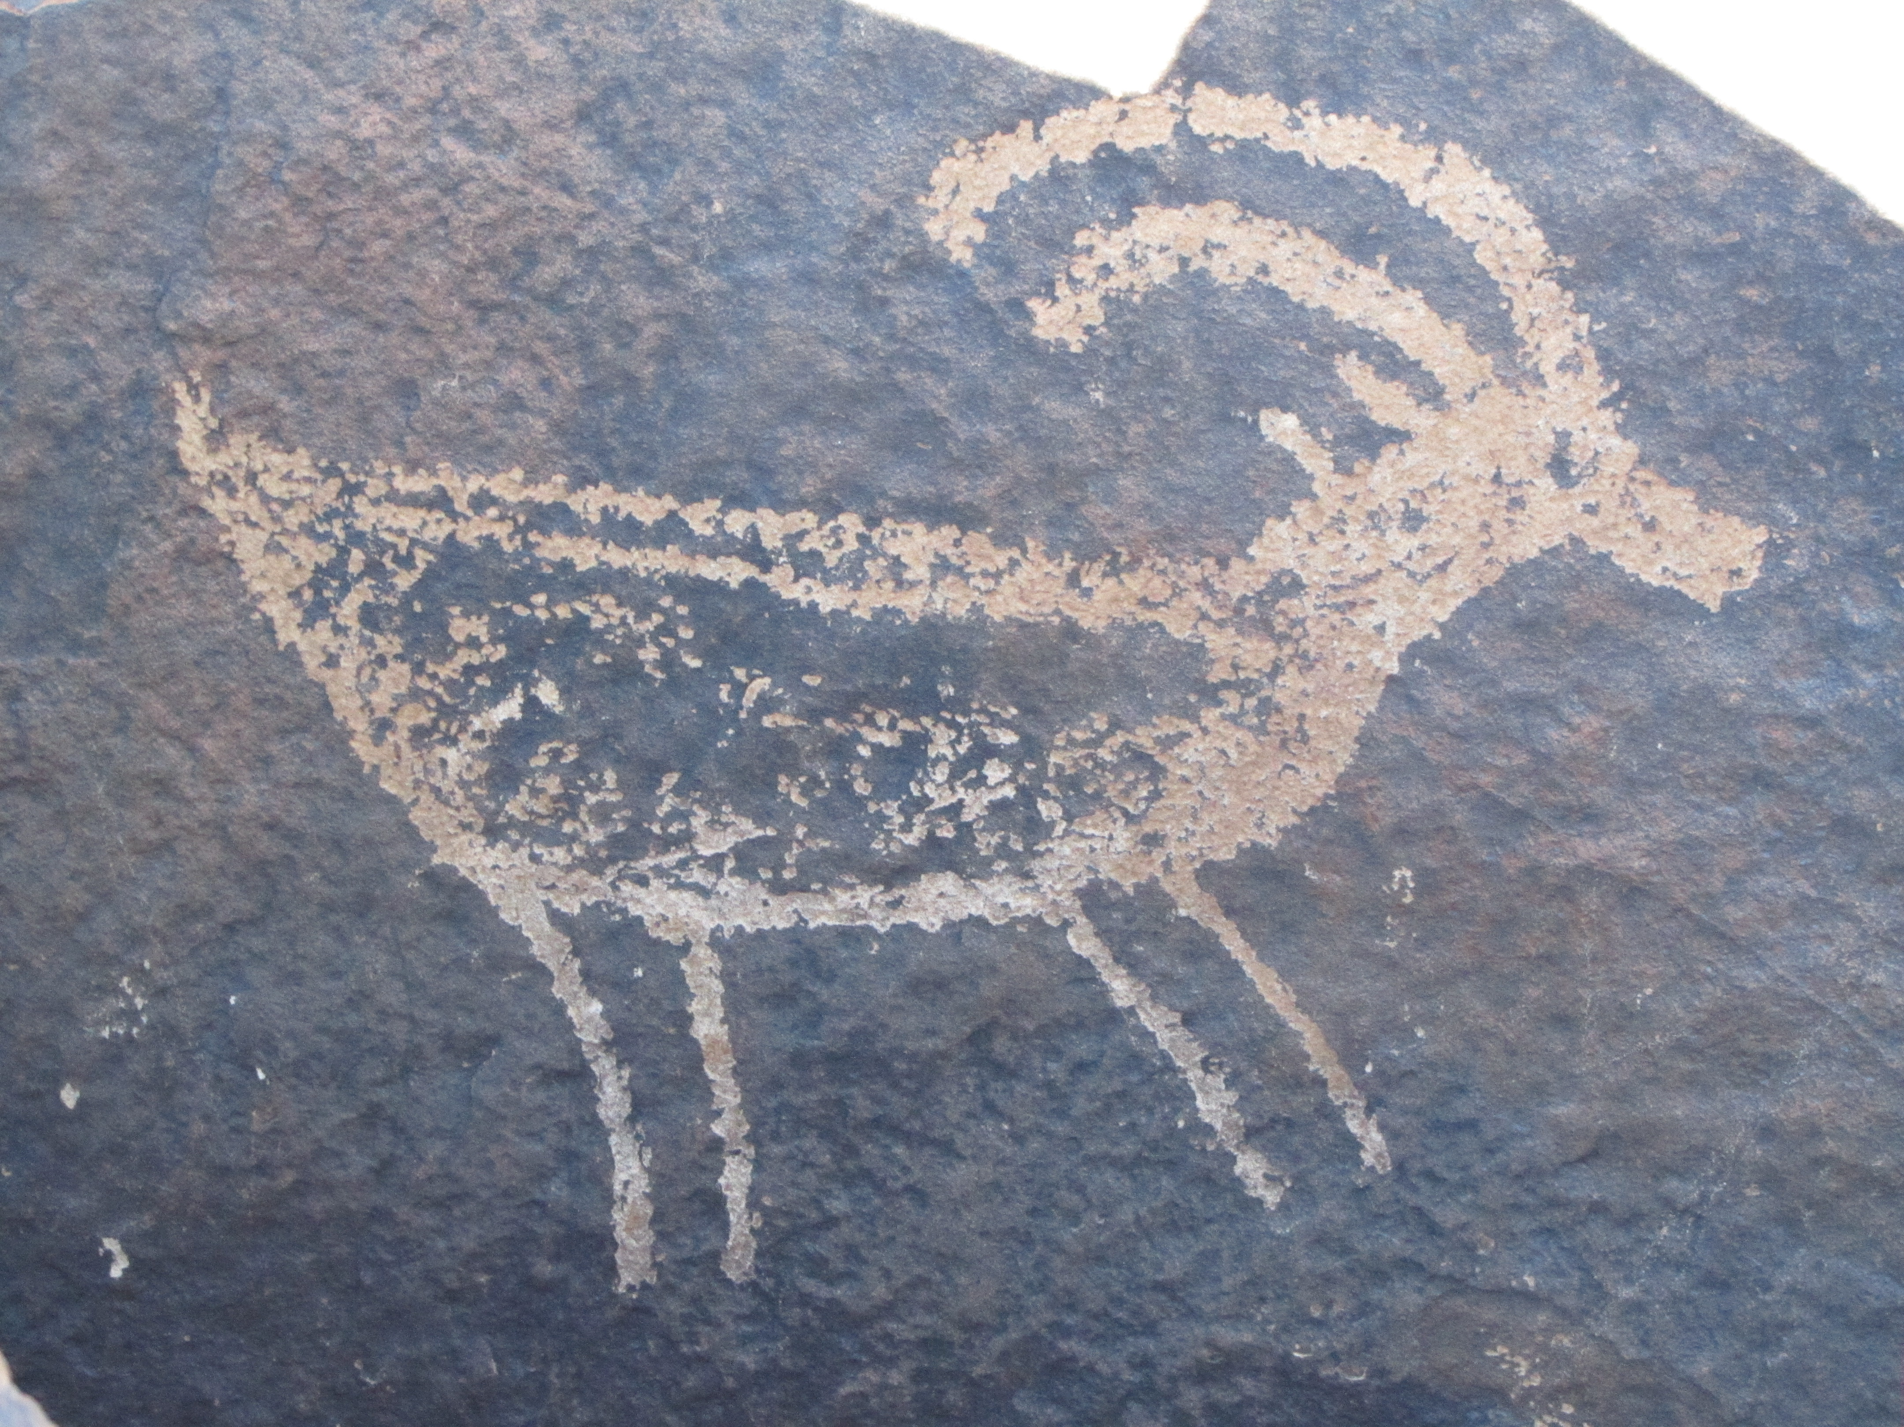
Notes:
In this petroglyph, the artist only pecked out the outline. This is more common.

Slide 18
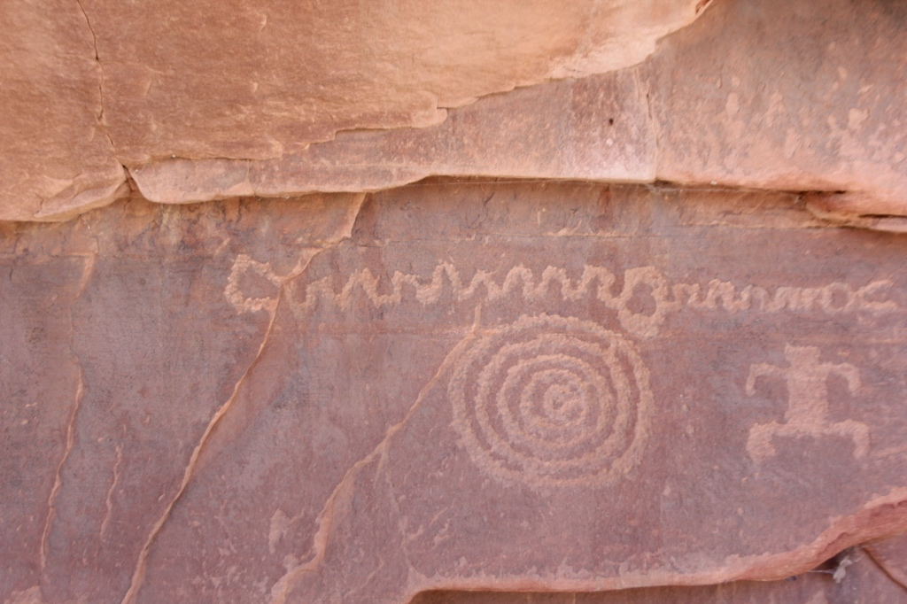
Notes:
Some panels of petroglyphs are huge as if they were newspaper rocks.

Slide 19
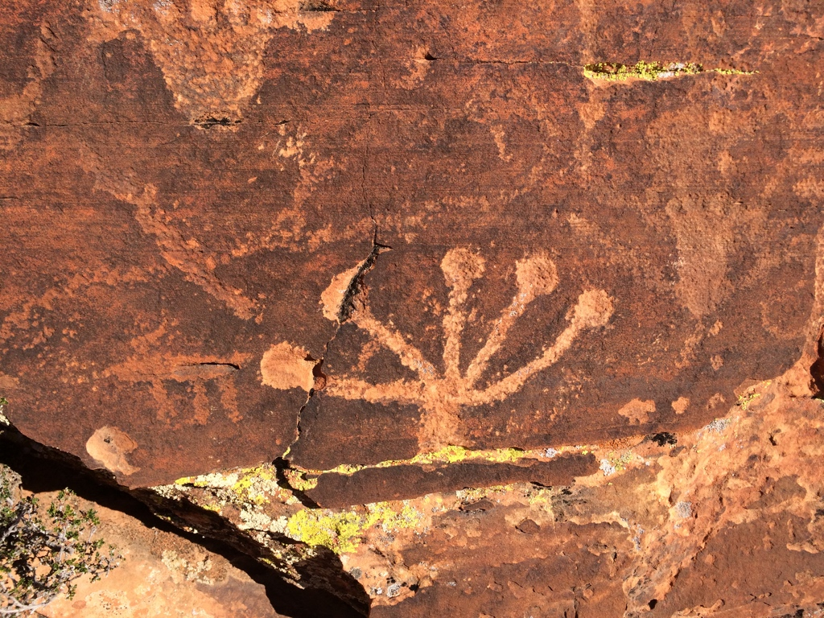
Notes:
Some panels of petroglyphs are huge as if they were newspaper rocks.

Slide 20
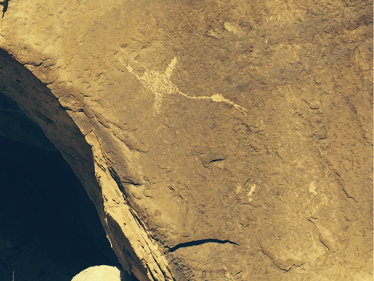
Notes:
Other petroglyphs are alone, the work of just one artist. Perhaps for a purpose. It is thought that this petroglyph, to the right of the entrance to the cave, guards a ceremonial cave.

Slide 21
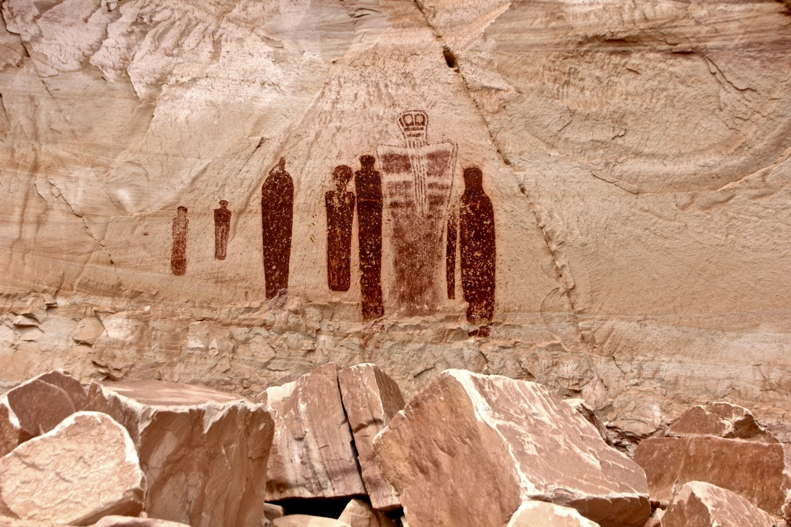
Notes:
Pictographs are painted on the rocks with pigments. Although there is nothing to compare to this, each of these figures is larger than life.

Slide 22
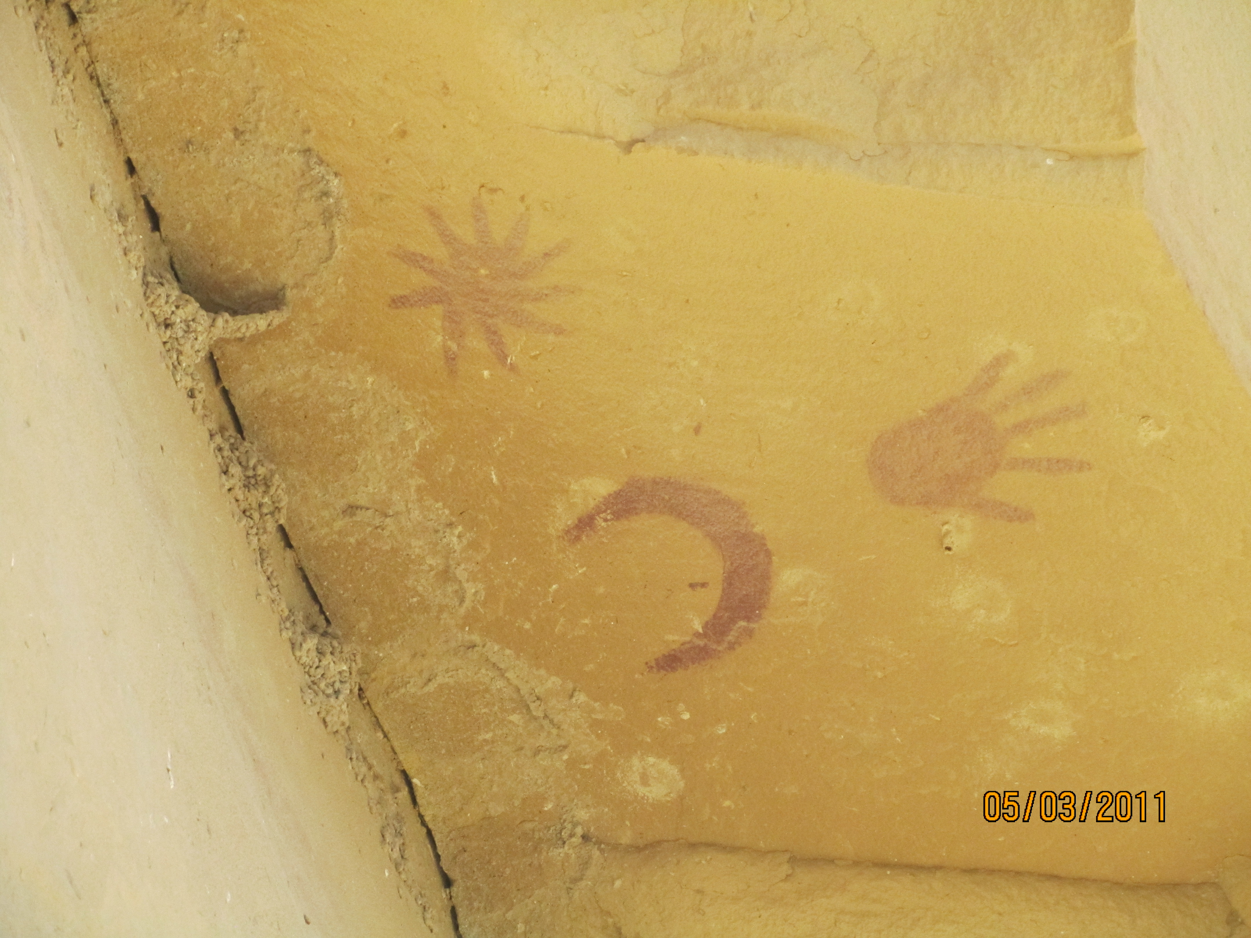
Notes:
Pictographs don’t last as long as petroglyphs unless they are in protected areas. These are under a ledge. The picture was taken looking up.

Slide 23
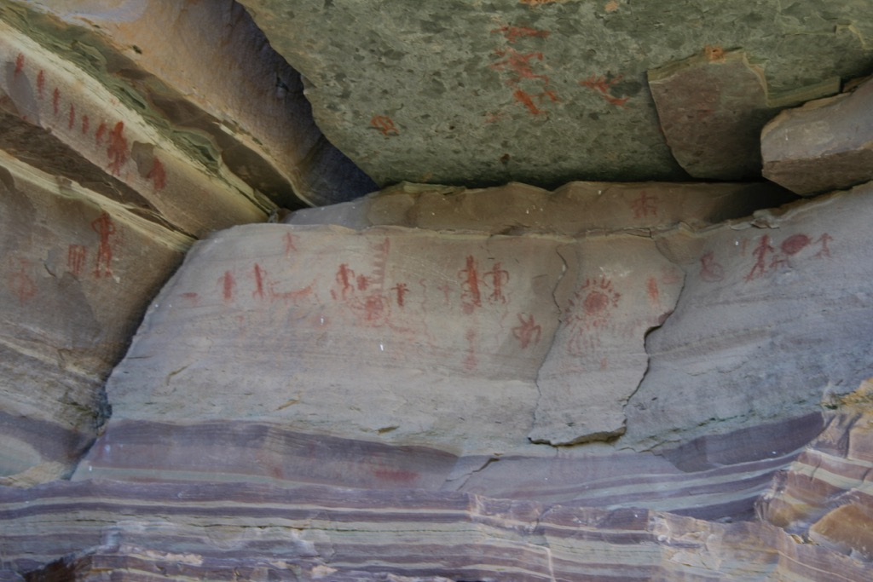
Notes:
These are inside a cave.

Slide 24
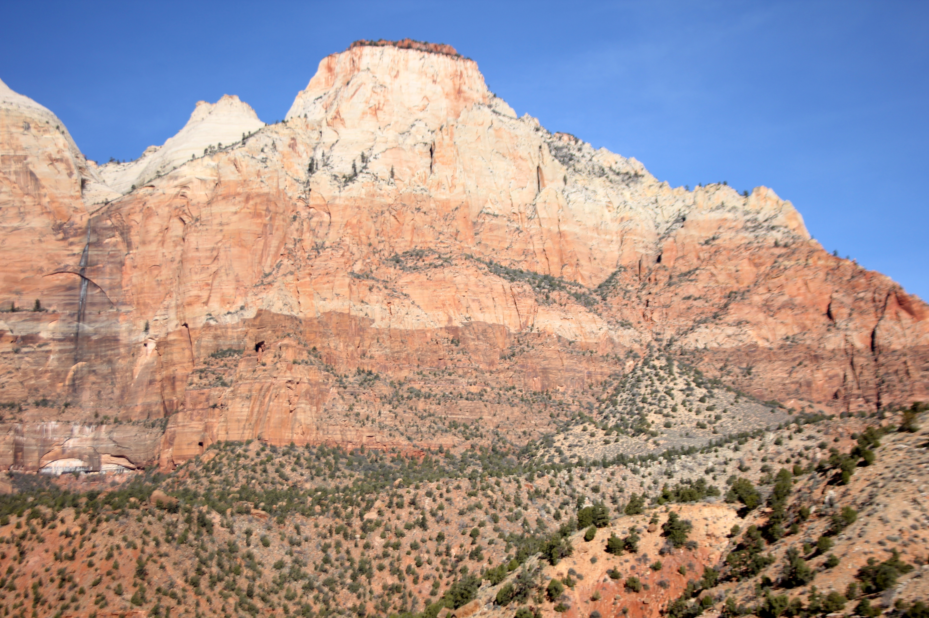
Notes:
Would you choose this as your home like the Paiutes did?

